Slide 1
Capstone EDA Project Playstore App Review Analysis
Presented By
DEDWAL DIPALI

Slide 2
CONTENTS
INTRODUCTION
OBJECTIVE
PROBLEM STATEMENT
DESCRIPTION OF DATASET
DATA CLEANING
DATA ANALYSIS AND DATA VISUALIZATION
CONCLUSION

Slide 3
INTRODUCTION
The Play Store App Review Analysis project is a data analysis project that involves analyzing user reviews of Android apps on the Google Play Store.
The goal of the project is to gain insights into user sentiment, identify common issues or complaints, and provide recommendations for app developers to improve their products.
The project involves collecting data on user reviews using web scraping tools or APIs, cleaning and processing the data, and conducting various analyses, such as sentiment analysis, topic modeling, and clustering.
The results of the analysis can be presented in the form of visualizations, reports, or dashboards.

Slide 4
OBJECTIVE
Understand Consumer behavior and demand, how they reacts to different categories of genres of google play store app
Find the most popular and trending apps in recent times
Find how small changes or update impacts on app performances
Analyze the reviews , ratings, sentiments of people towards various app play store
Above all, help developers or clients to recognize the gap, make the app better and meet customer expectations

Slide 5
PROBLEM STATEMENT
1.What are the top categories on Play Store?
2.Are majority of the apps Paid or Free?
3.How importance is the rating of the application?
4.Which categories from the audience should the app be based on?
5.Which category has the most no. of installations?
6.How does the count of apps varies by Genres?
7.How does the last update has an effect on the rating?
8.How are ratings affected when the app is a paid one?
9.How are reviews and ratings co-related?
10.Lets us discuss the sentiment subjectivity.

Slide 6
DESCRIPTION OF DATASET
There are two datasets play store or user reviews
Play store data set-
1.App: The name of the application.
2.Category: The category to which an application belongs.
3.Rating: The ratings given by the users for a specific application.
4.Reviews: The total number of users who have given a review for the application.
5.Size: The size being occupied the application on the mobile phone.
6.Installs: The total number of installs/downloads for an application.
7.Type: The application is free or a paid one.

Slide 7
DESCRIPTION OF DATASET
8.Price: The price of the application.
9.Content_Rating: The target audience for the application.
10.Genres: The various other categories to which an application can belong.
11.Last_Updated: The when the application was updated.
12.Current_Ver: The current version of the application.
13.Android_Ver: The android version which can support the application on its platform.

Slide 8
DESCRIPTION OF DATASET
USER REVIEWS -
1.App: It contains the name or identifier of the app.
2.Translated_Review: It contains the text of the review
3.Sentiment: It contains the overall sentiment of the review (e.g. positive or negative)
4.Sentiment_Polarity: It contains a measure of the positivity or negativity of the review
5.Sentiment_Subjectivity: It contains a measure of the subjectivity or objectivity of the review.

Slide 9
DATA CLEANING
Data cleaning is the process of fixing or removing incorrect, corrupted, incorrectly formatted, duplicate, or incomplete data within a dataset.
When combining multiple data sources, there are many opportunities for data to be duplicated or mislabeled. If data is incorrect, outcomes and algorithms are unreliable, even though they may look correct.
There is no one absolute way to prescribe the exact steps in the data cleaning process because the processes will vary from dataset to dataset. But it is crucial to establish a template for your data cleaning process so you know you are doing it the right way every time.

Slide 10
DATA CLEANING
Data cleaning steps :
Removing unwanted values - Deleting of duplicate values.
Handling missing values - Handling missing values in our dataset.
Handling structural error - Fixing mislabeled categories or classes.
Replacing the missing values - replacing missing values with mean is the most popular method of replacing missing values.
Filtering Unwanted Outliers- Removing incorrect or unwanted outliers.

Slide 11
DATA ANALYSIS AND DATA VISUALIZATIONS
Visualize the dataset which apps most install or how many apps are free or paid.
Using visualization method found out which apps rating high or their reviews .
Top 50 app are found they most use or install and their rating also high.
Compare to the free apps or paid app and in 50 apps find the highest free install app and paid install app.
Analysis the highest app in free install apps that helps to business where to invest money which type of apps people are loved and paid app install analysis that is people which apps buy .
The analysis the apps it impacts on business they see their benefits.

Slide 12
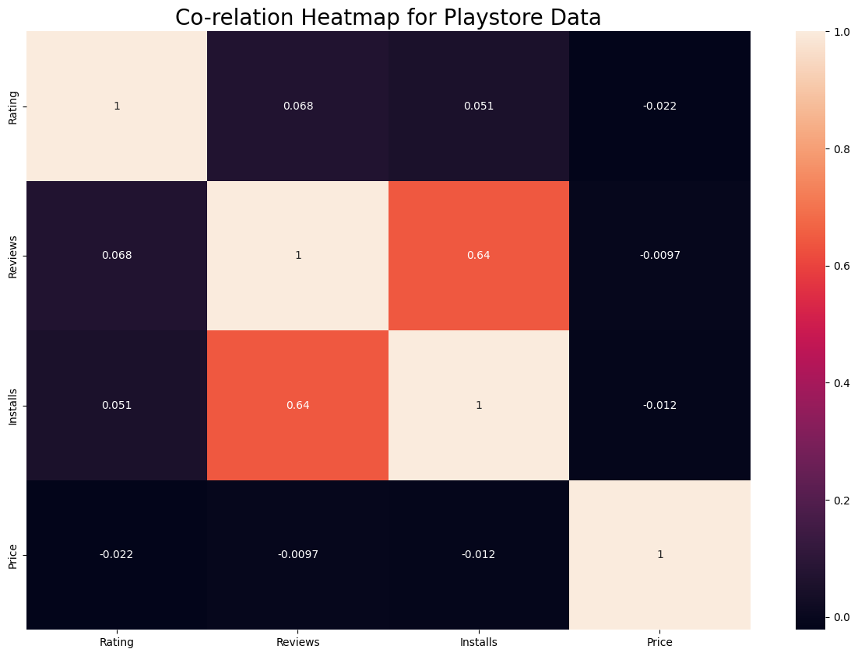
DATA ANALYSIS AND DATA VISUALIZATIONS
Co - Relation Heatmap for playstore :
Heatmaps are a type of graphical representation that is commonly used in data analysis and visualization. Heatmaps are useful for displaying large amounts of data in a way that is easy to interpret and understand.
There is a majority of positive correlation between the Installs and Reviews columns. Greater the number of installs, higher is the user base, and major are the total number of reviews posted by the users.
The Price is slightly negatively correlated with the Reviews, and Installs the average rating, total number of reviews and Installs decrease gradually.The Rating is marginally positively correlated with the Installs and Reviews` column.

Slide 13
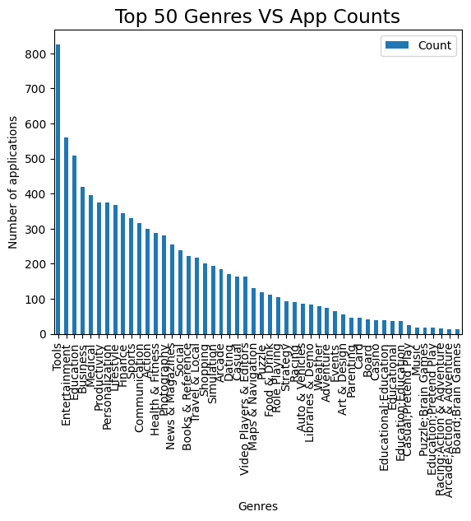
DATA ANALYSIS AND DATA VISUALIZATIONS
Top 50 genres vs App counts :
Using bar graph are a type of graphical representation that are commonly used to display and compare data.
For the play store genre and count & Bar graphs are a versatile and useful tool for data analysis and visualization because they allow you to compare and display data in a visually appealing way, summarize data, and show trends over time or across categories.

Slide 14
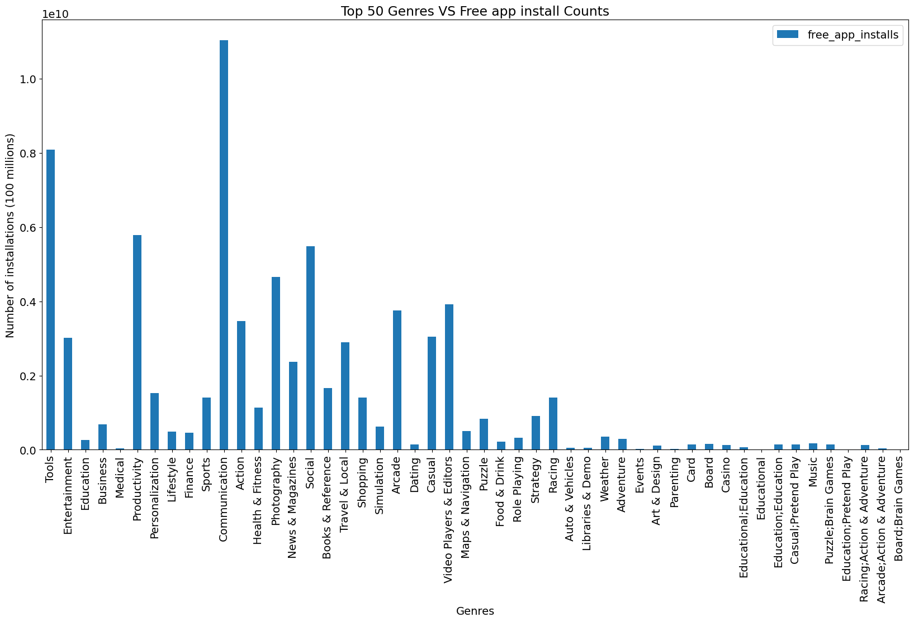
DATA ANALYSIS AND DATA VISUALIZATIONS
Top 50 genres vs Free app install:
The bar graph represent the highest genre in the free install app are the exploring.
The insights are: The genre having the highest number of free apps installed is communication and Most people having low trust on genres like parenting,medical shows.
This has no specific impact on business because it’s just the valid compare between two categories. Free form of any communication applications are widely used. And most of the contribution in the categories are social.

Slide 15
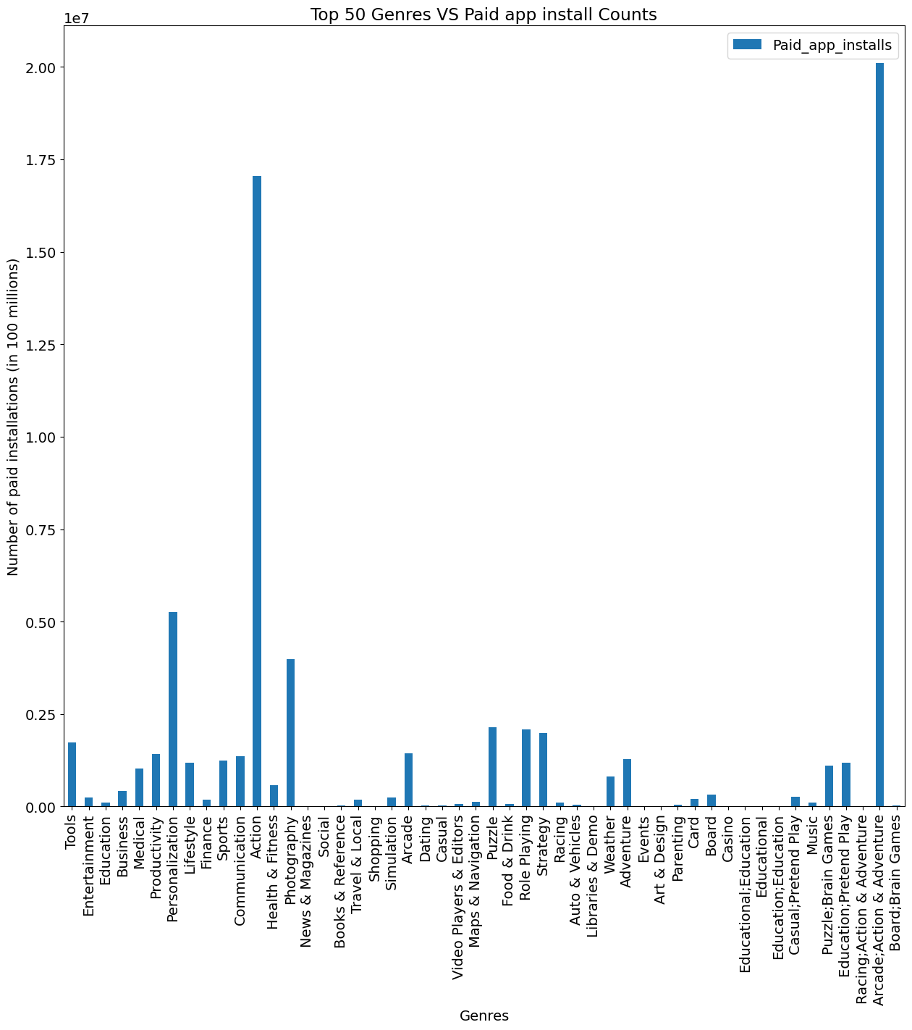
DATA ANALYSIS AND DATA VISUALIZATIONS
Top 50 genres vs Paid apps install :
This bar explore the highest paid application.
Most install the arcade-action and adventure and most of the this generation like to games, people buy anything for games they paid game are playing.most people not interested in paid apps.
The insight negative sign as generation interested in free app than paid , so some companies investing and making the game app and this game app are paid because people love the game so company see most profits.

Slide 16
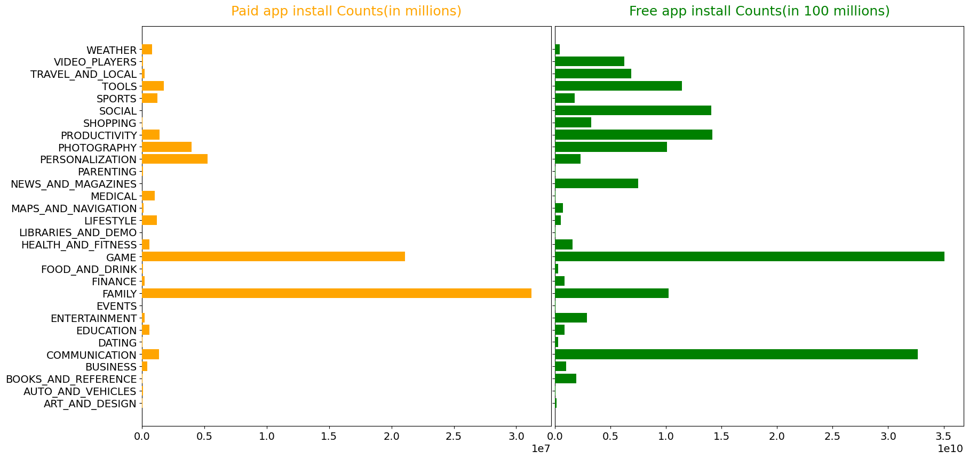
DATA ANALYSIS AND DATA VISUALIZATIONS
Different between Paid app install and Free app install :
According to the stats, most paid apps are in family and games category.
Apart from these no other category is doing good in making money.
This also indicates that if the service provided is good and secured with quality, it will certainly create a positive impact on business and no otherwise.

Slide 17
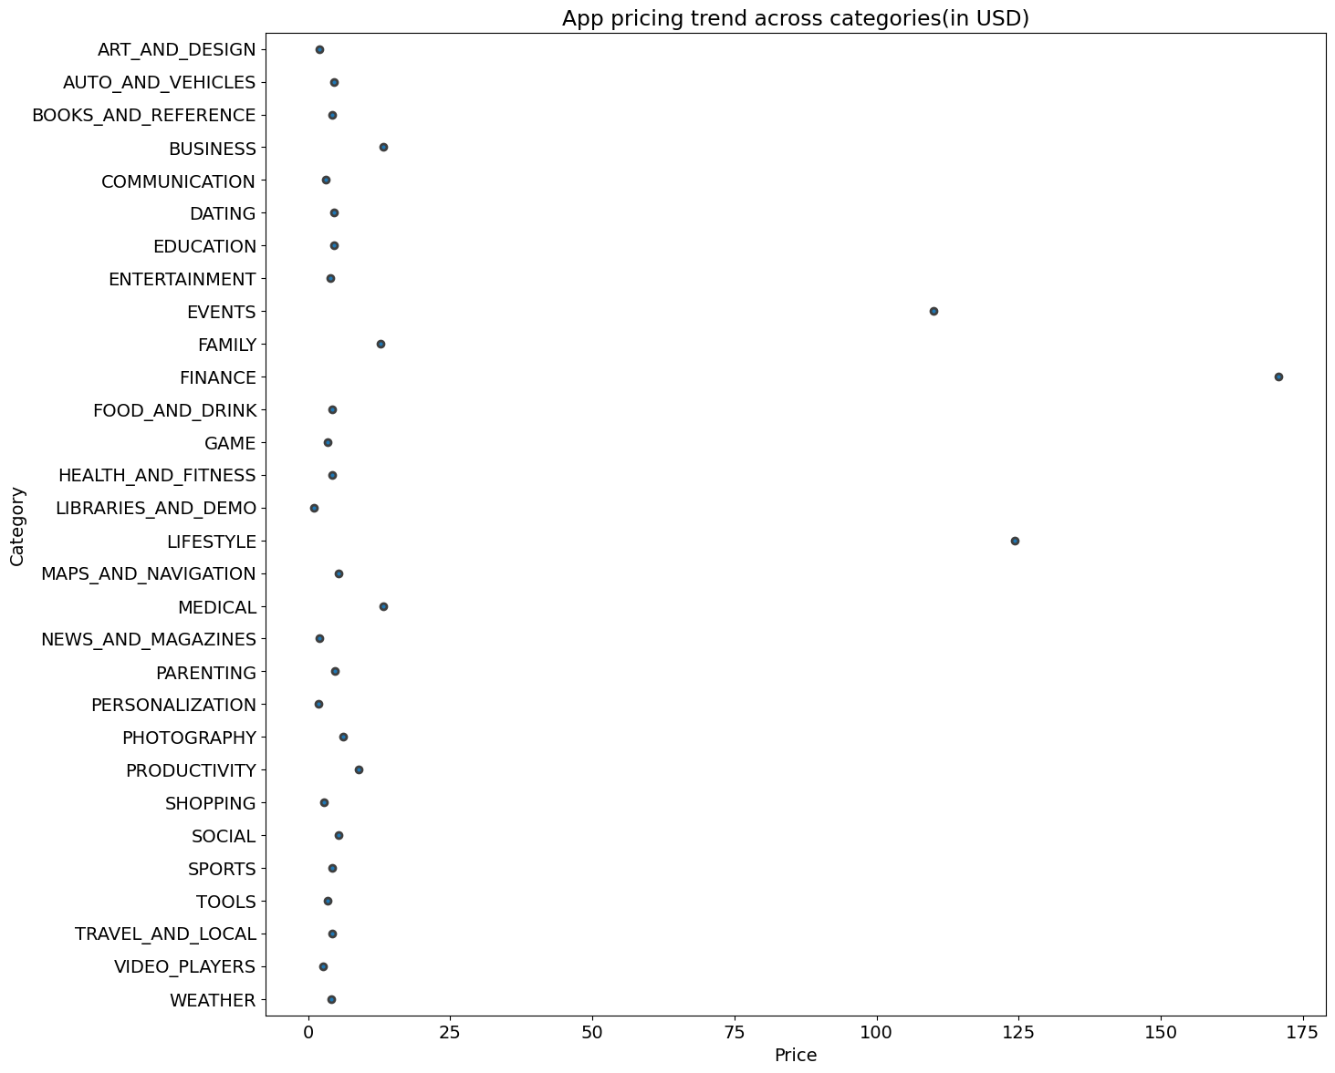
DATA ANALYSIS AND DATA VISUALIZATIONS
App pricing trend across categories(in USD) :
Most apps are priced under 25USD and Finance category has the highest priced app followed by lifestyle
Lowest priced category is libraries and demo.
As this is just the trend of pricing categories this may not decide the business.
But what it gives out is an idea of on how much an app can charge according to there particular category and what their competitors are charging in the market

Slide 18
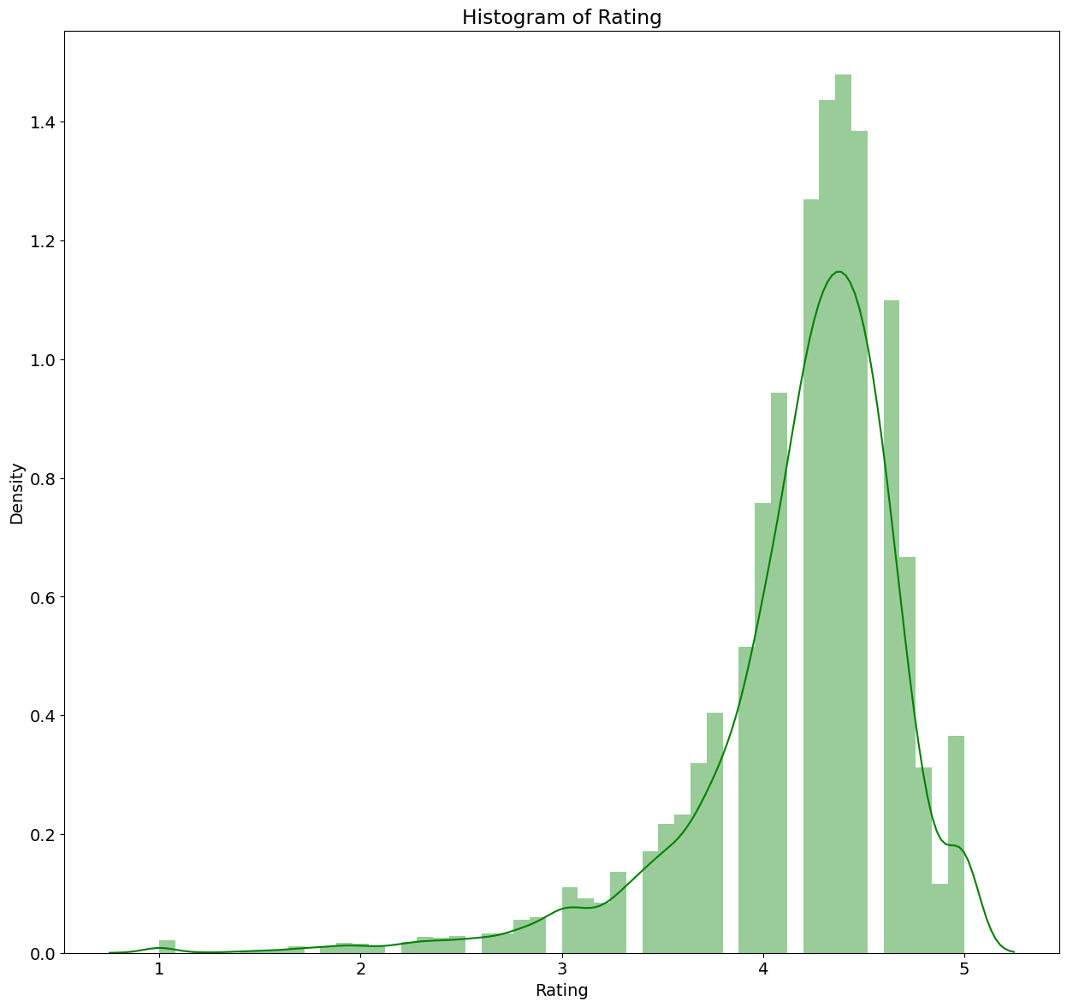
DATA ANALYSIS AND DATA VISUALIZATIONS
Histogram of rating:
To find analysis based on App Rating and We get a summarized information of liked and disliked app by a number of users all around the world.
Most apps have the rating between 4 to 5 Also shows us most apps are liked by many users depending on ease of use, functionality, performance and less bugs.
A positive impact on business, because now they have the users trust they can experiment on scaling the app and with pricing.
Increase their functionality globally. Reduces advertisement cost. Mainly they can also divert this traffic to their next projects which helps them becoming a brand

Slide 19
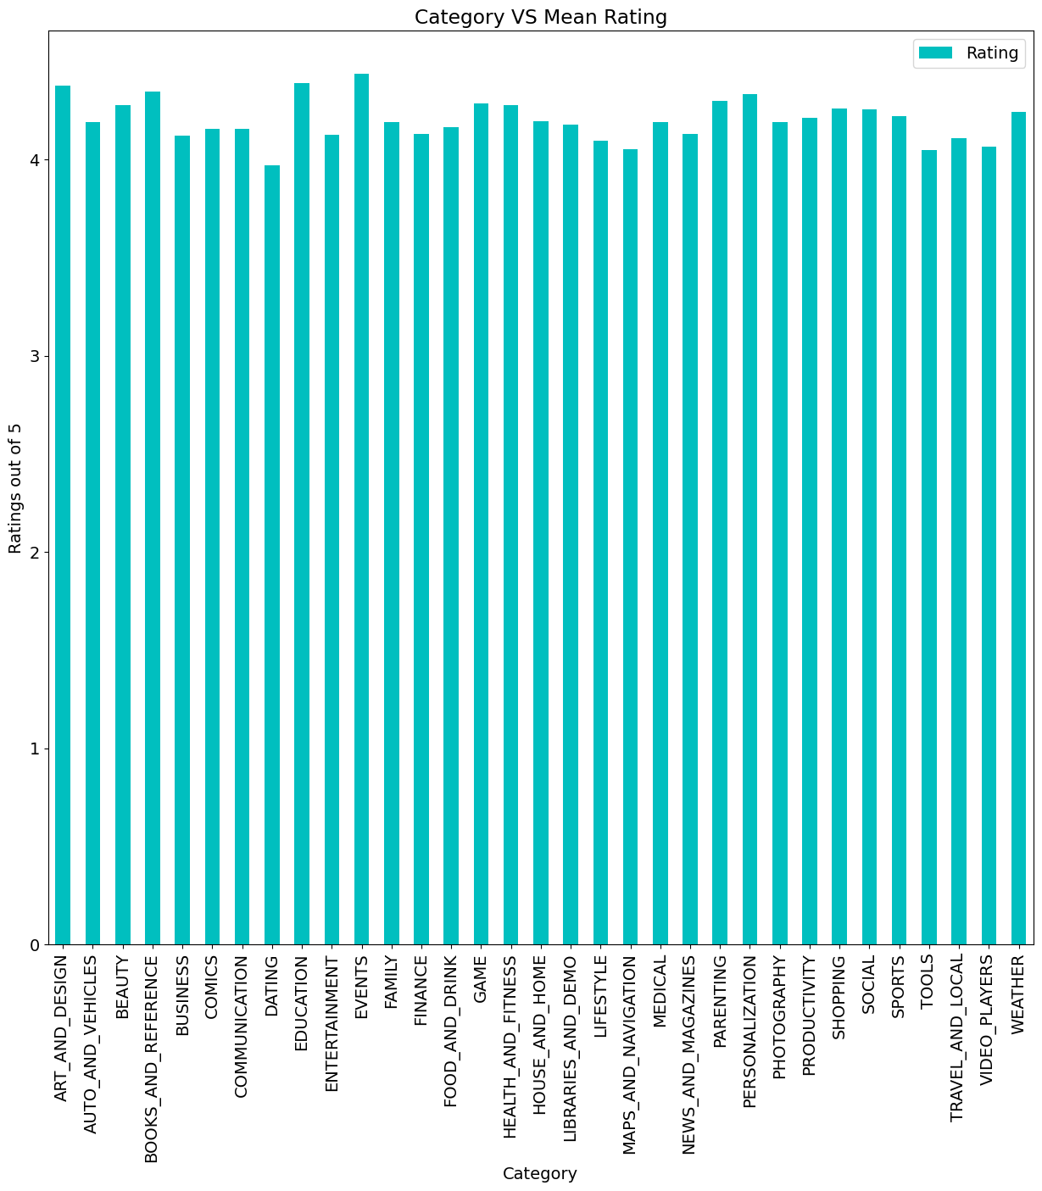
DATA ANALYSIS AND DATA VISUALIZATIONS
Category vs Mean Rating: Finding the category wise mean rating.

Slide 20
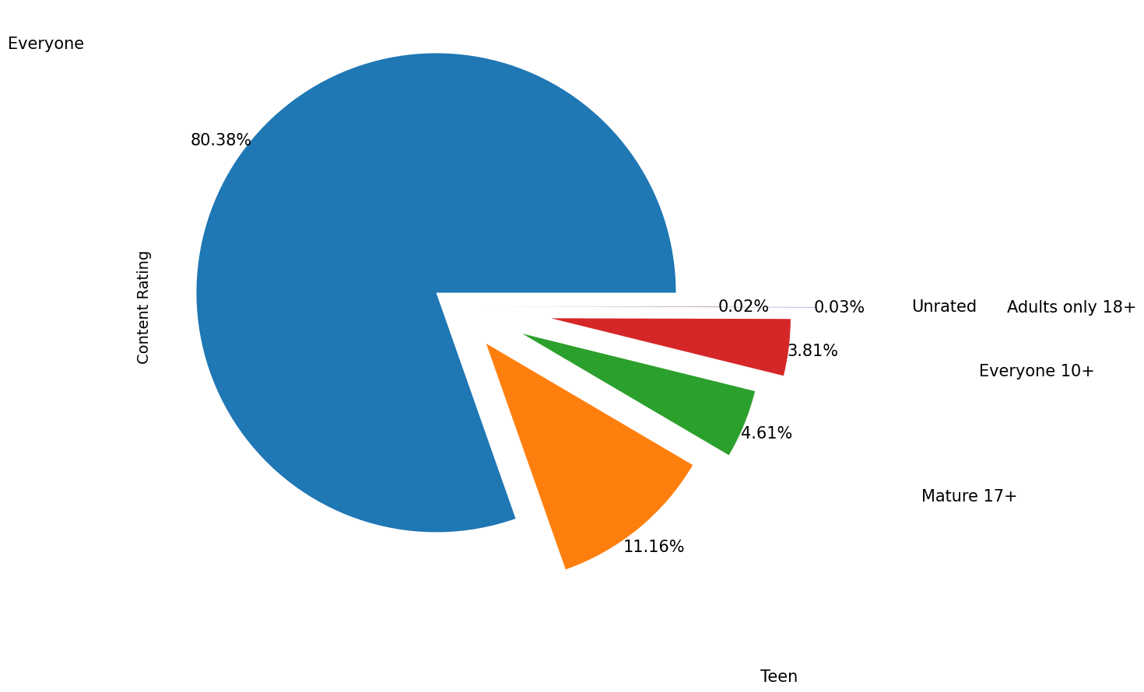
DATA ANALYSIS AND DATA VISUALIZATIONS
Pie chart of the age group of people : Going with this content rating most creators are targeting every age group. So that would be the wise choice to go for a positive business impact. Choosing teen content as the niche category can also feature growth. Mostly family-friendly content categories will win the race

Slide 21
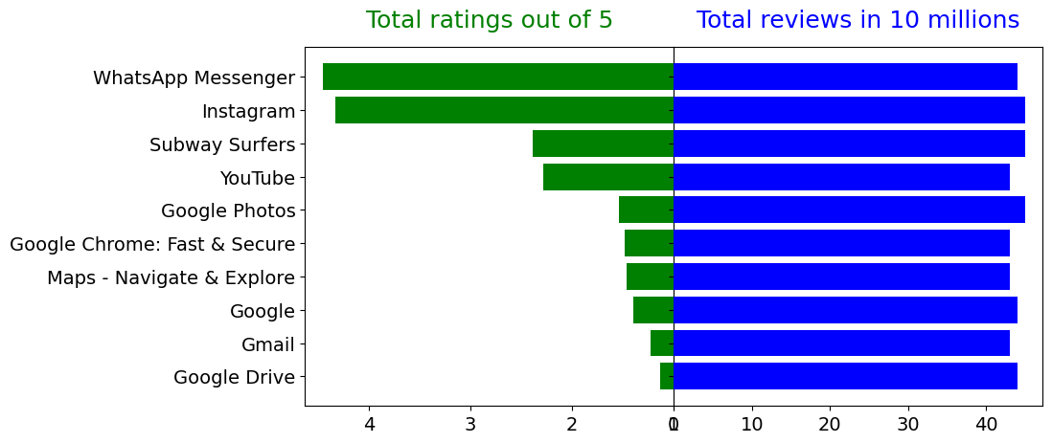
DATA ANALYSIS AND DATA VISUALIZATIONS
Top 10 apps and their rating and reviews:
Both of the top rated apps are from social media/communication with above 4 rating(out of 5) and rest all are below 3 rating
Reviews of all the 10 apps are of same level.
Exceptional difference in ratings are seen in between top 2 and rest of the top 10

Slide 22
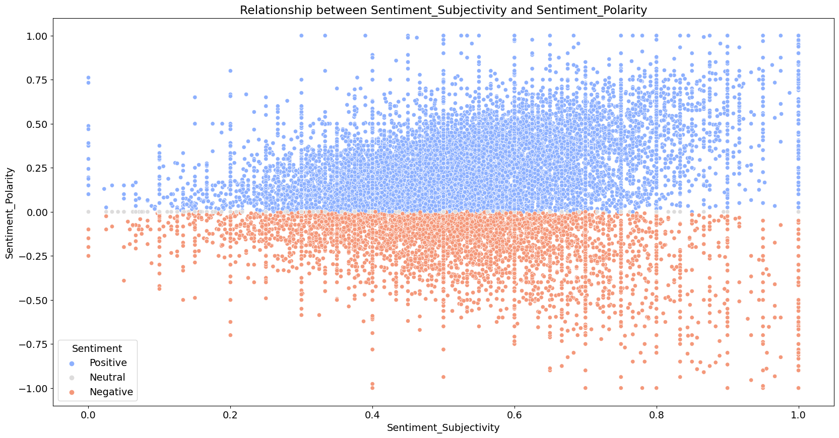
DATA ANALYSIS AND DATA VISUALIZATIONS
Relationship between Sentiment_Subjectivity and Sentiment_Polarity

Slide 23
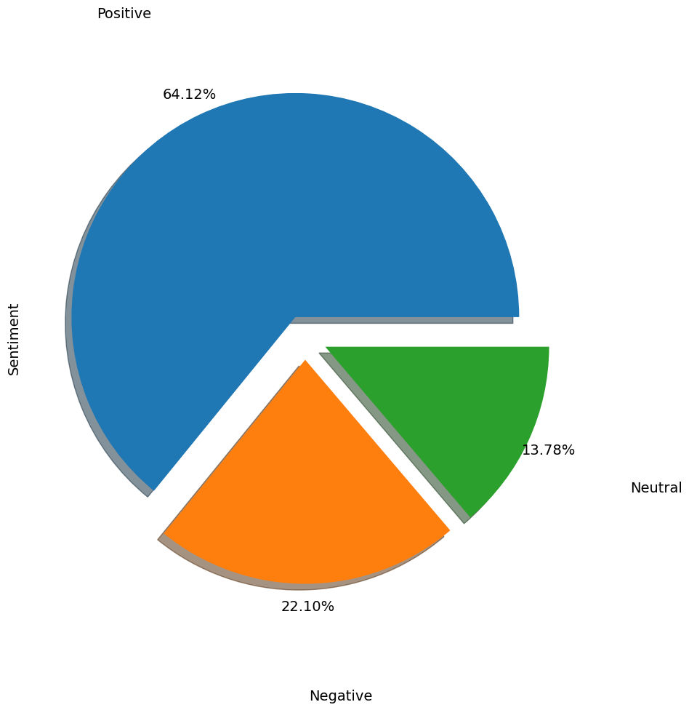
DATA ANALYSIS AND DATA VISUALIZATIONS
Pie chart represent the sentiment analysis

Slide 24
CONCLUSION
Through exploratory data analysis we have observed some trends and have made some assumptions that might lead to app success among the users in the play store.
Percentage of free apps is ~92% and percentage of apps with no age restrictions is ~82%.
Most competitive category in paid and free: Family and Games & Family, Game and Tools are top three categories having 1906, 926 and 829 app count.
Apps having size less than 50 MB are 8783. 7749 Apps are having rating more than 4.0 including both type of apps.
Category with the highest average app installs: Game & percentage of apps that are top rated is ~80%.
There are 20 free apps that have been installed over a billion time & Category in which the paid apps have the highest average installation fee: Finance
The median size of all apps in the play store is 12 MB & The apps whose size varies with device has the highest number average app installs.
The apps whose size is greater than 90 MB has the highest number of average user reviews, ie, they are more popular than the rest.
Overall sentiment count of merged dataset in which Positive sentiment count is 64%, Negative 22% and Neutral 13%.
Sentiment Polarity is not highly correlated with Sentiment Subjectivity.

Slide 25


